Slide 1
Gender Bias Detection
समान - सम्मान
Suyash and Jainit

Slide 2
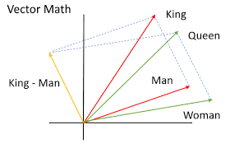
Word embedding system
The most important feature of word embeddings is that similar words in a semantic sense have a smaller distance (either Euclidean, cosine or other)
“Ped” and tree will have almost the same word
Embedding despite being in different languages
due to sense similarity

Slide 3
How Word Embeddings are Created
Read the text

Slide 4
How Word Embeddings are Created
Read the text
Preprocess text

Slide 5
How Word Embeddings are Created
Read the text
Preprocess text
Create (x,y) data points

Slide 6
How Word Embeddings are Created
Read the text
Preprocess text
Create (x,y) data points
Create one hot encoded (X,Y) matrices

Slide 7
How Word Embeddings are Created
Read the text
Preprocess text
Create (x,y) data points
Create one hot encoded (X,Y) matrices
Train a neural network

Slide 8
How Word Embeddings are Created
Read the text
Preprocess text
Create (x,y) data points
Create one hot encoded (X,Y) matrices
Train a neural network
Extract the weights from the input layer
Code*(vectors)

Slide 9
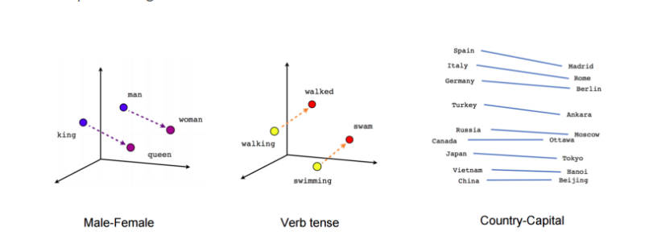
How Word Embeddings are Created

Slide 10
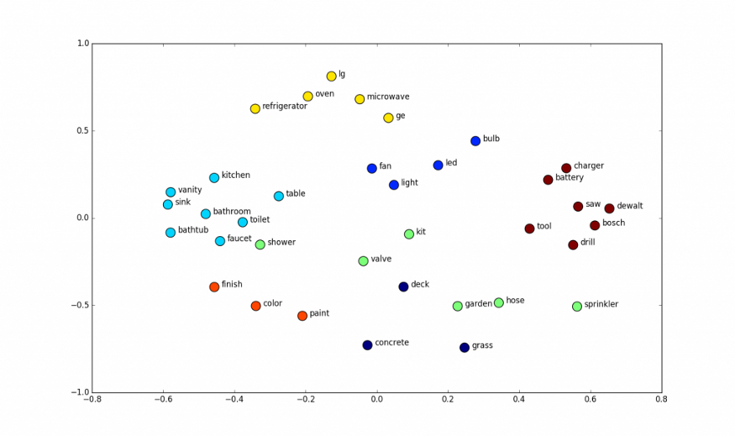
Vector space

Slide 11
Our Methodology for Hindi Word Embeddings
Extraction of Data through Web Scraping and creation of Corpus for different Data sets like Wikipedia , News Articles
Creation of Word embeddings Using Python Library
Formation of Text Library of different domains like , intelligence , strength , Arts , Sports ,etc .
Formation of Text libraries of inherently Male or Female words .
Comparison of Euclidean and Cosine Similarites of Vectors To analys Possibilty of Gender Bias in every domain taking inheritent library as base
Error Analysis Based on Neutral Gender Words and already Exhisting Word Embedding Models .

Slide 12
Corpus Creation
Use of Libraries Beautiful , html5lib, re
Corpus Cleaning Use re for removal of disallowed characters and emojis .
Different from english as Hindi Inflections contain Gender information unlike English .
Eg. Kamlesh Went to eat . कमलेश खाना खाने गया ।
Lemmatization and Stemming was not done due to the scare of losing important information

Slide 13
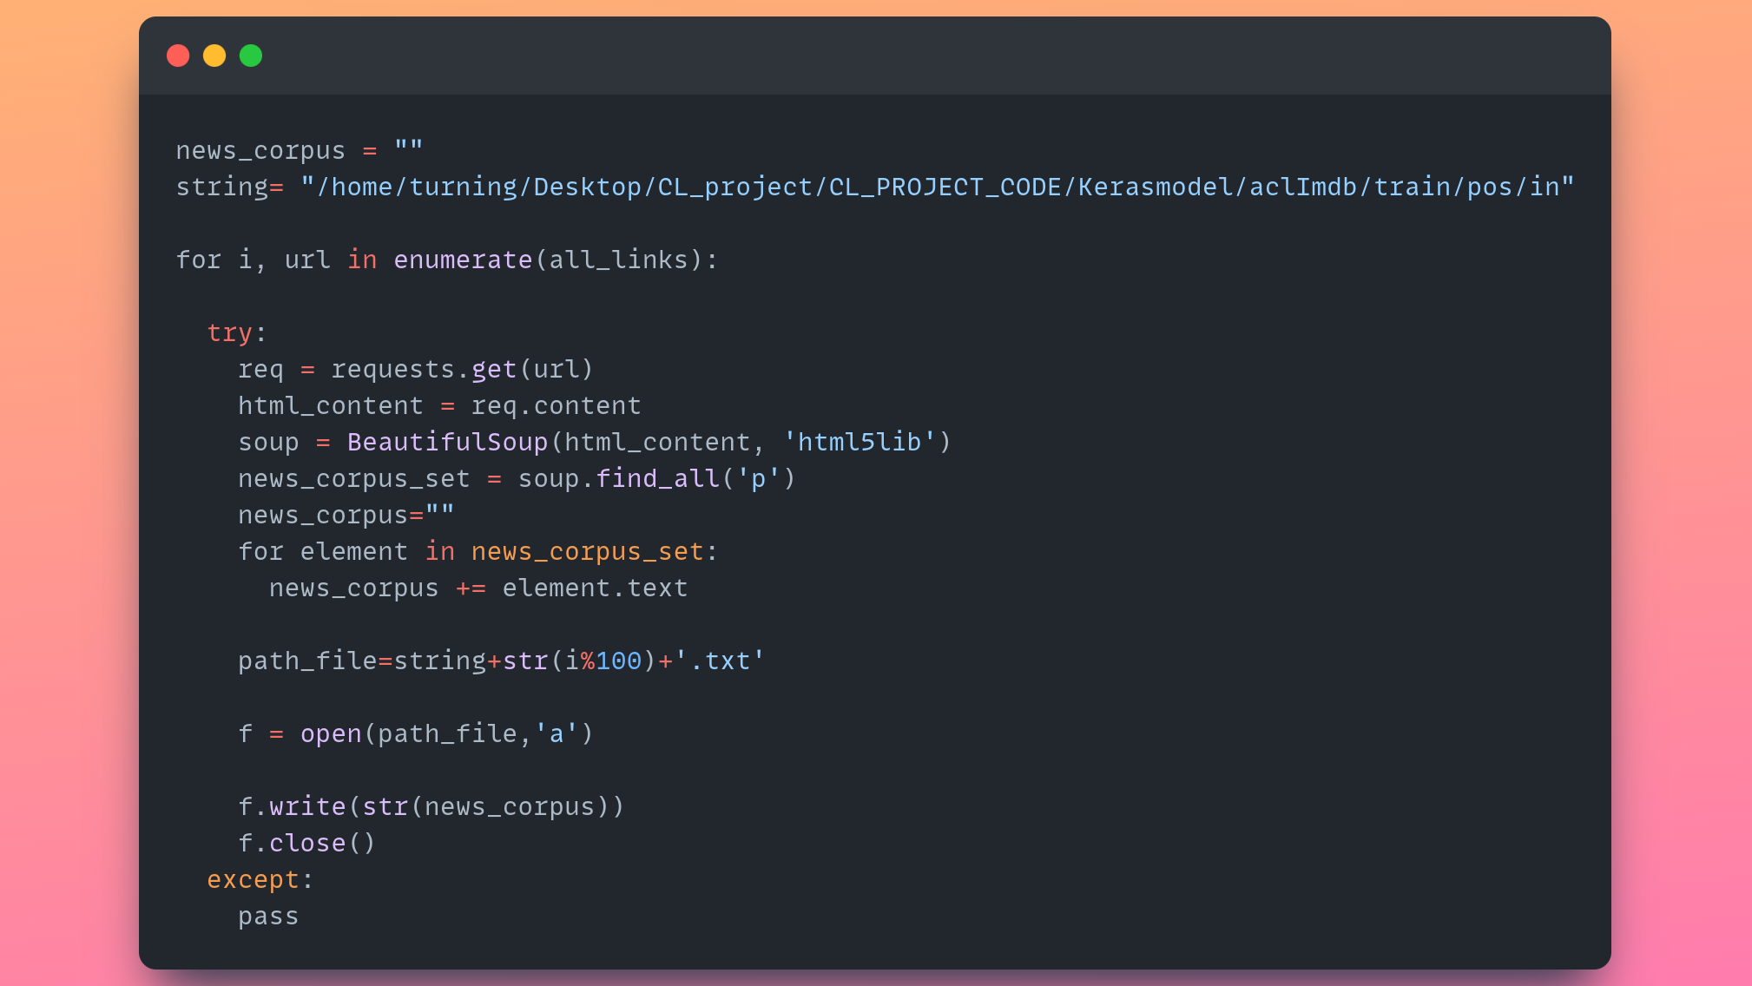

Slide 14
Corpus Creation
5. Removal of Stop Words like '▁मैं','▁मेरे','▁मुझे','▁उसने','▁हमारे','▁हमें', ,etc
Special care was taken to not remove stop words which contained Gender Information like उसका उसकी .
Neutral gender words were retained like उसके
Stop words were removed after the formation of Word Embeddings so that no information is lost .
6. Statistics :-
We collected a total of 1.2 lakh sentences to train our Model from ABP news site and approximately 8 lakh words

Slide 15
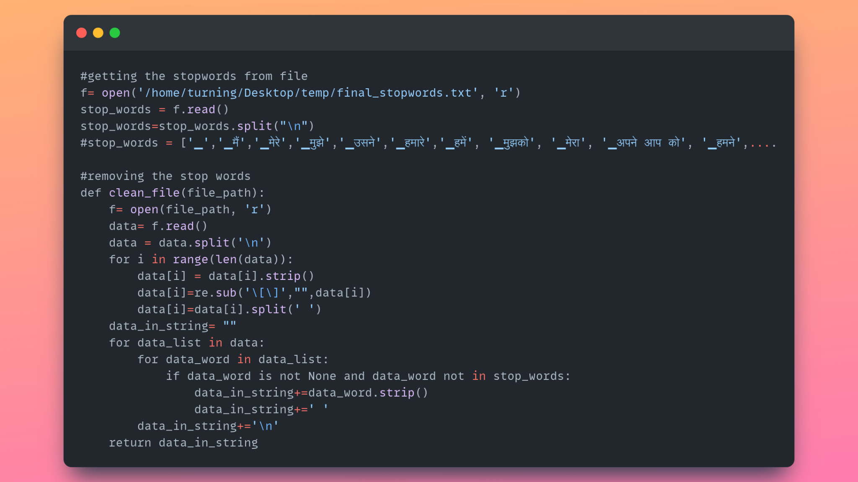

Slide 16
Creation of Word embeddings
1. Then input files were created to be fed into the model.
2. Word embeddings were created using two different libraries,
Gensim library
Keras library

Slide 17
Gensim Library
This has modules that implement the word2vec family of algorithms, using highly optimized C routines, data streaming and Pythonic interfaces.
Gensim module also has some pretrained models. They are in english, ofcourse.
We made our word embedding using this library in hindi. Using around 50Mb of corpus around.
We scraped the corpus and then give the data in required format.
The words were then transformed to vectors

Slide 18
Keras Library
Keras offers an Embedding layer that can be used for neural networks on text data.
It requires that the input data be integer encoded, so that each word is represented by a unique integer.
The Keras Embedding layer can also use a word embedding learned elsewhere.
Keras provides the one_hot() function that creates a hash of each word as an efficient integer encoding.
Then the encodings go through the embedding layer and they are transformed to vectors.
Code*

Slide 19
Challenges during designing the word embeddings
The major challenge was training the corpus.
We chose corpus which was only about 120000 sentences.
We therefore had a bad frequency distribution.
Therefore we had to compromise with the accuracy.
The morphology in Hindi was another challenge because there were so many words having the same root and we couldn’t run lemmetiser or stemmer as the morpheme contains valuable information on Gender .
How many dimensions to use?
How many Epochs ?

Slide 20
Text Libraries
Text Libraries were created with regard to different domains which we suspected to have Gender bias .
Strength vs Weakness
Family vs Career
We Made 2 Lists of Inherentetly_male_terms and inherently_female_terms which act as a reference to calculate the similarity .
Male terms = नर,आदमी,लड़का .etc
Female terms = नारी,औरत,लड़की ,etc
GITHUB

Slide 21
Comparisons and Analysis
We now compare the vectors formed for any bias
Euclidean Distance Analysis
We first select a domain where we want to analyse the Gender Bias .
We then calculate the average distance of all the vectors of that domain with all vectors of inherently male and female terms and take its ratio .

Slide 22
Hypothesis Testing
Hypothesis 1= the corpus biased towards male gender (Ratio>1.1)
Hypothesis 2 = the Corpus is Biased Towards Female Gender . (Ratio<0.9)
Hypothesis 3 = the Corpus is not biased (0.9<Ratio<1.1)
The Ratio 1.1 and 0.9 have been calculated by the use of hypothesis Testing by converting the Function into a Normal distribution Function .

Slide 23
Cosine Similarity
In this method we use 2 domains to compare Gender bias
Eg. Family vs Career
We create an average (Male - Female) Vector and We create and average (Career - Family) vector and take their cosine similarity as the basis for comparison .

Slide 24
Euclidean Distance
So we measured the euclidean distance of average of all male terms vector with different domains in weat list.
We did the same with the female average vector.
We then compared the euclidean distance across different domains.
We took ratio of the distance of domains with male to euclidean distance with female vector.
Eu_ratio = eu_dist(male , domain)/ eu(female, domain)

Slide 25
Results
Domain | Male/Female | Comment
Intelligence | 0.957744 | No conclusion as hypothesis 3
Math | 1.127872 | Male are more into maths.
Arts | 0.803066 | Female are more inclined towards arts field.
Strength | 1.94027 | male are shown more powerful.
Weakness | 0.963201 | Hypothesis 3
Appearance | 1.11305 | Good appearance words are used for males.
Family | 1.07047 | Hypothesis 3 but still more inclined towards the hypothesis Men are more family person , which was unexpected. ( opposite of the hypothesis )
Career | 1.356091 | Men are more exposed to career than Women.
Science | 0.924645 | Women are inclined towards science field.

Slide 26
Observations
There are some domains where the news channel seems to be biased like the ‘intelligence’ field , ‘career’ field , ‘Math’.
Interesting thing to observe is that strength related terms are also used and also weakness represented terms are used which indicates that some articles empower women but some just try to weakenise women by using weakness terms.
Another possibility is that it is just noise in the data as the data set is very small.

Slide 27
Conclusions
We conclude that Gender Bias is Present in most of the domains but many domains are still Neutral or unbiased in the ABP news Data .
Many Hypothesised Domains which were considered to be Bias towards one Gender were found to Neutral .

Slide 28
Error Analysis
We analysed the errors in this system using 2 methods
Using Gender Neutral Words
Using another Word Embedding Model Trained on a larger Corpus and Known to be Gender Unbiased .

Slide 29
Using Gender Neutral Words
We use Gender neutral terms and compare their euclidian distance from average man vector - average women Vector .
Ideally it should be same but this would show us the error .

Slide 30
Using INLTK embeddings
We would chose a set of words to compare the embeddings between our embeddings and INLTK embedding and their comparison would give us error in our analysis assuming that INLTK is unbiased .

Slide 31
Upgradation …
This Analysis could be extended to all the Indian Languages with the information of inflection of different languages.
Various news channels, blogs can be checked for bias using this model.
Removal of Gender Bias using a suggestion model to change certain words , a system which prescribe the correct vocabulary.

Slide 32
धन्यवाद !!

